Slide 1
Quantifying Electrostatic Fields at Protein Interfaces Using Classical Electrostatics Calculations
Andrew W. Ritchie
Adviser: Lauren J. Webb
The University of Texas at Austin
Department of Chemistry
Notes:
Hi, my name is Andrew Ritchie and today I will be discussing my dissertation research: Quantifying Electrostatic Fields at Protein Interfaces using Classical Electrostatics Calculations

Slide 2
Quantifying Electrostatic Fields at Protein Interfaces Using Classical Electrostatics Calculations
Multi-Dimensional Umbrella Sampling
Ragain, C. M.; Newberry, R. W.; Ritchie, A. W.; Webb, L. J., Role of Electrostatics in Differential Binding of RaIGDS to Rap Mutations E30D and K31E Investigated by Vibrational Spectroscopy of Thiocyanate Probes. J Phys Chem B 2012, 116 (31), 9326-9336.
Ritchie, A. W.; Webb, L. J., Optimizing Electrostatic Field Calculations with the Adaptive Poisson-Boltzmann Solver to Predict Electric Fields at Protein-Protein Interfaces I: Sampling and Focusing. J Phys Chem B 2013, 117 ( 39), 11473-11489.
Numeric Poisson Boltzmann Equation vs Reaction Field Method
Ritchie, A. W.; Webb, L. J., Optimizing Electrostatic Field Calculations with the Adaptive Poisson-Boltzmann Solver to Predict Electric Fields at Protein-Protein Interfaces I: Sampling and Focusing. J Phys Chem B 2013, 117 ( 39), 11473-11489.
Selective Explicit Water in Poisson Boltzmann Solutions
Ritchie, A. W.; Webb, L. J., Optimizing Electrostatic Field Calculations with the Adaptive Poisson-Boltzmann Solver to Predict Electric Fields at Protein-Protein Interfaces II: Explicit Near-Probe and Hydrogen-Bonding Water Molecules. J Phys Chem B 2014, 118 (28), 7692-7702.
Atomic Multipole Optimized Energetics for Biomolecular Applications (AMOEBA)
Notes:
Overall, I’ve looked at multiple enhanced MD methods and ways of calculating electrostatics fields. However, the majority of my works has been on…
I’ve used 2D umbrella sampling to ensure a good ensemble of probe orientations
I’ve looked at multiple ways of solving the PBE and compared them to experimental data
I’ve looked at the importance of identifying structural water for PB electrostatics
I’ve looked at using a polarizable force field for electrostatics
----- Meeting Notes (8/5/15 16:06) -----
Went through this too fast. It's really the summary of everything I have done. Add citations to papers. This is not translating to that fact that this is projects that I have worked on. Try to make this more big-picture.

Slide 3
Outline
Importance of Protein Electrostatics
Vibrational Stark Effect
System: Rap1a Docked to RalGDS
Protein Electrostatic Fields
Poisson Boltzmann vs Reaction Field Method
Select Explicit Water
Electronic Polarizability: AMOEBA
Notes:
First I’m going to tell you why it is important to understand protein electrostatics

Slide 4
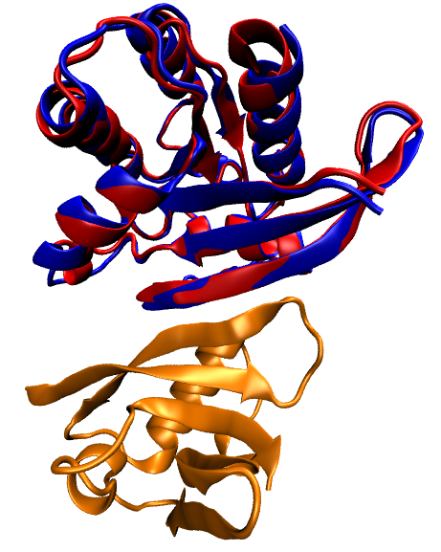
Why Study Protein Electrostatics?
Ragain, et al., J. Phys. Chem. B 2012
Huang, et al., Nat. Struct. Bio. 1998
Nassar, et al., Nat. Struct. Bio. 1996
Notes:
To do so, I first need to mention structure. Here we see two GTPases, p21 Ras (red) and Rap1a (blue), where the backbones have been aligned. Structurally, they are nearly identical. However, they bind the downstream effector, Ral Guanosine Dissociation Stimulator, with an order of magnitude difference in dissociation constant. Because they are so structurally similar, electrostatics must be responsible for this selectivity.
50% amino acid identity
80% amino acid homology
0.7 Å effector binding surface RMSD
----- Meeting Notes (8/5/15 16:06) -----
Say "Protein electrostatics are the forces caused by the orientation and locations of charges in space, as related to proteins". I'm not telling them what electrostatics are.

Slide 5
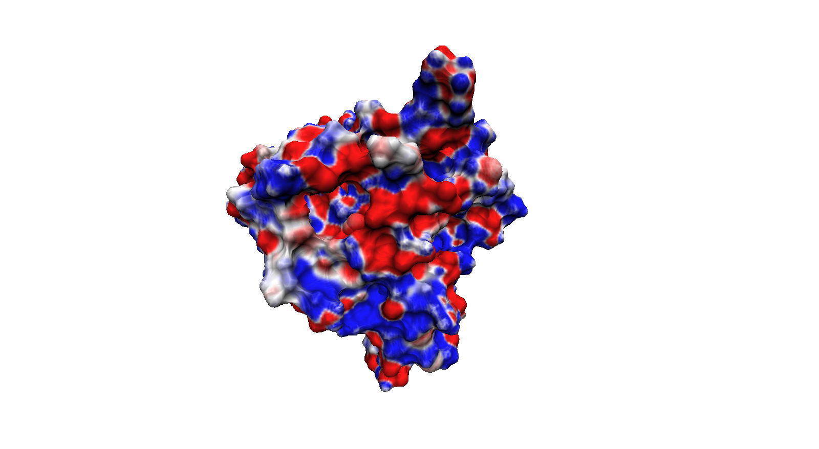
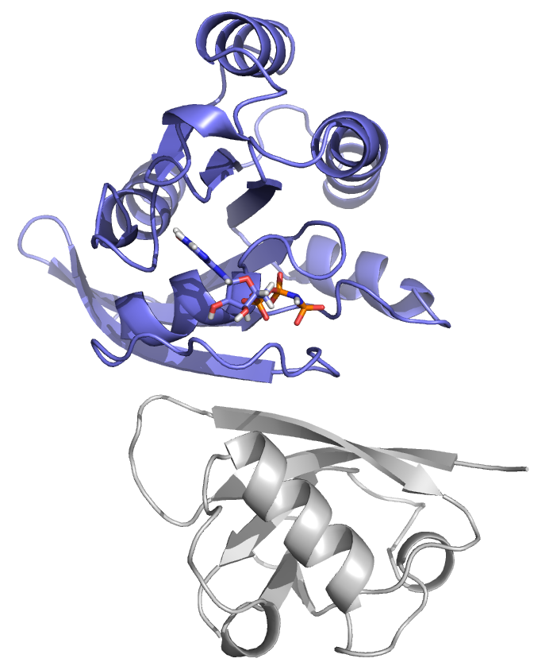
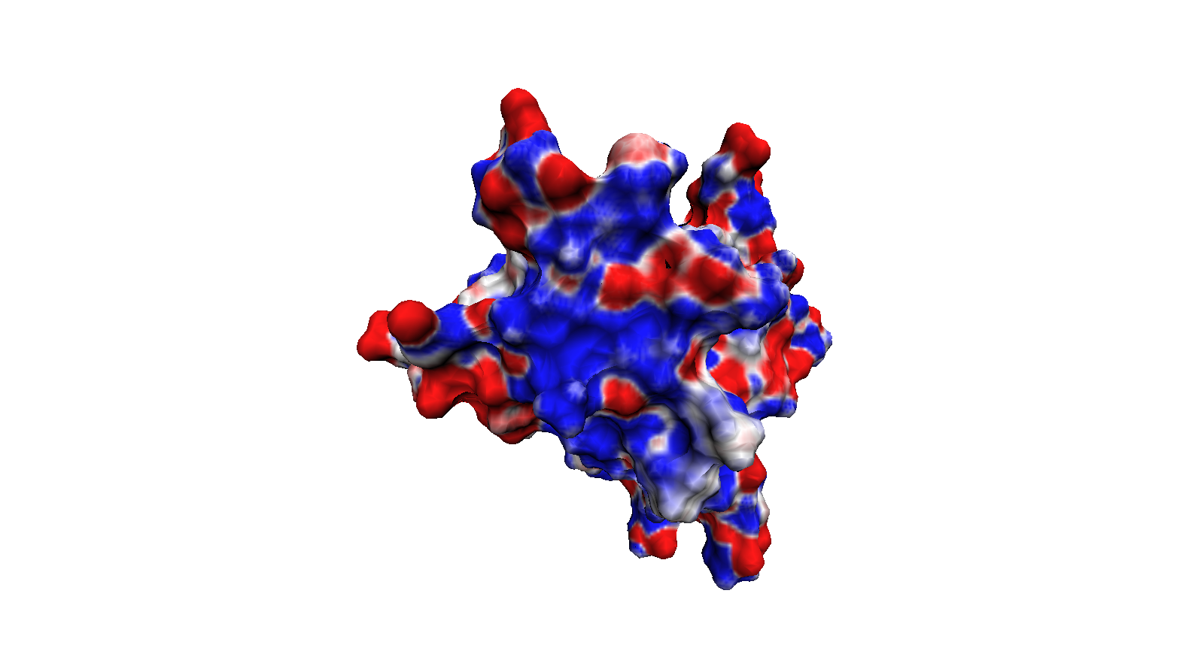
Why Study Protein Electrostatics?
≥ +25 MV/cm
GTPase
Effector
≤ -25 MV/cm
Notes:
In fact, doing a simple Poisson-Boltzmann electrostatics calculation on a protein shows that the electrostatic topology is very heterogeneous. This is demonstrated by the structure on the left, p21 Ras bound to Ral, where the protein complex has been opened like a book, so the figure on the top is looking at the binding surface of Ras from the perspective of Ral and the figure on the bottom is the binding surface of Ral from the perspective of Ras. Here we have mapped the component of the electrostatic that is perpendicular to the surface to the surface. We can see that the field is not only heterogeneous, but spans a large range, more than 50 MV/cm.
So if protein electrostatics are important, how do we experimentally look at them?

Slide 6
Outline
Importance of Protein Electrostatics
Vibrational Stark Effect
System: Rap1a Docked to RalGDS
Protein Electrostatic Fields
Poisson Boltzmann vs Reaction Field Method
Select Explicit Water
Electronic Polarizability: AMOEBA
Notes:
We look at protein electrostatic fields using the vibrational stark effect

Slide 7
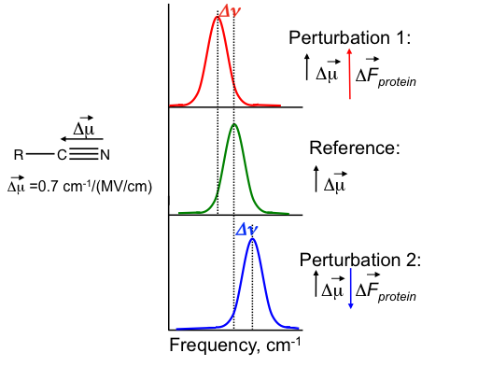
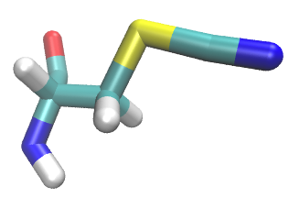
Probing Protein Electrostatics Using the Vibrational Stark Effect (VSE)
Notes:
The VSE is a way to relate changes in electrostatic fields perpendicular to some vibrational chromophore dipole moment with changes in vibrational absorption energy. In our case, we are looking at cyanocysteine as our vibrational chromophore.
Don’t spend too long on this: VSE is a way to relate changes in electrostatic fields with vibrational absorption energy shifts
----- Meeting Notes (8/5/15 16:06) -----
Try not to say red and blue shift, try to say increase and decrease absorption energy.

Slide 8
Outline
Importance of Protein Electrostatics
Vibrational Stark Effect
System: Rap1a Docked to RalGDS
Protein Electrostatic Fields
Poisson Boltzmann vs Reaction Field Method
Select Explicit Water
Electronic Polarizability: AMOEBA
Notes:
So we know how to measure protein fields. Now let me take a moment to introduce our experimental system.

Slide 9
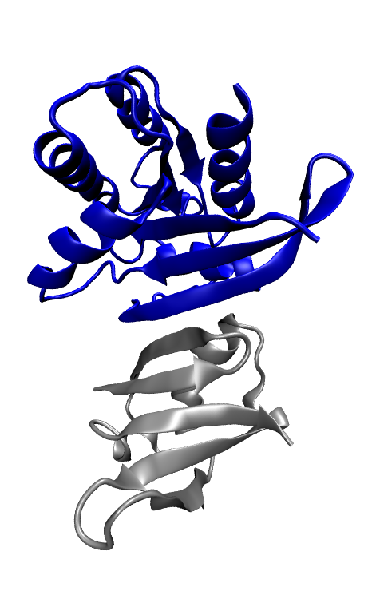
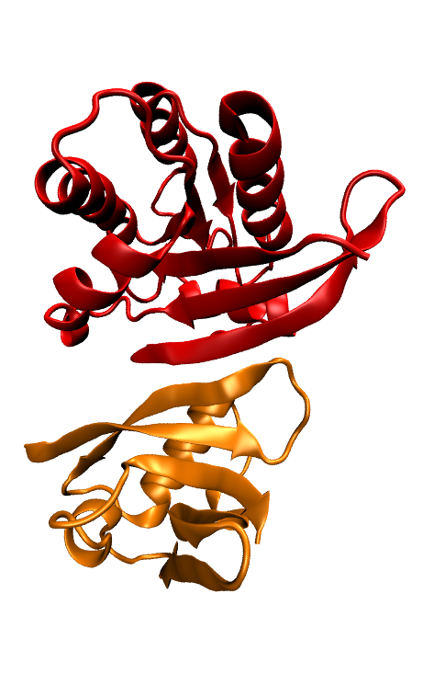
System: GTPases Rap1a and p21 Ras, Each Docked to RalGDS
1GUA:
Rap1a
Raf
1LFD:
p21 Ras
RalGDS
Notes:
On the left is the crystal structure of Rap1a docked to Raf, 1GUA, and p21 Ras docked to RalGDS, 1LFD.
----- Meeting Notes (8/5/15 16:06) -----
On the top is the GTPase and on the bottom is the effector. What we're looking at is the docking of the GTPase to the effector.
WT Rap/Ral:

Slide 10
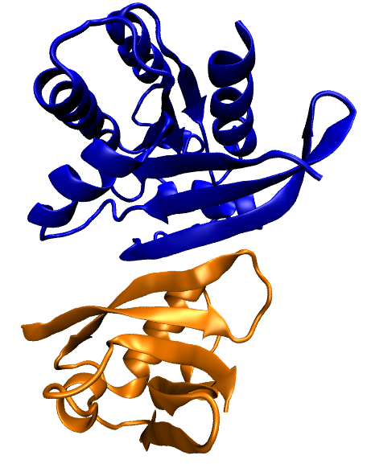
System: GTPases Rap1a and p21 Ras, Each Docked to RalGDS
1GUA:
Rap1a
1LFD:
RalGDS
Notes:
In the work I’m going to present, I am looking exclusively at Rap1a docked to its downstream effector, RalGDS.

Slide 11
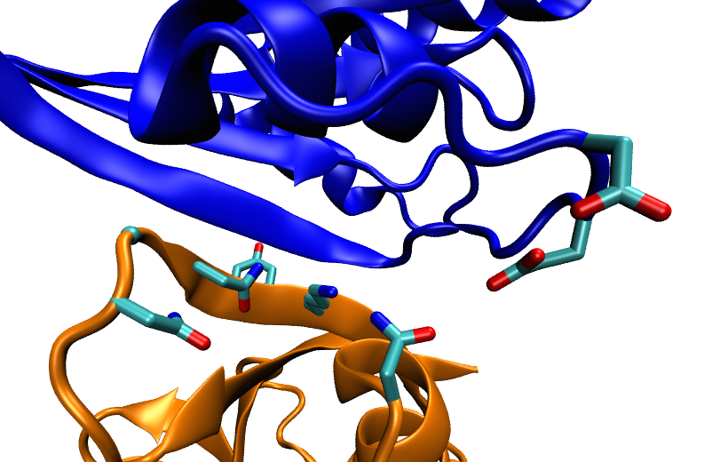
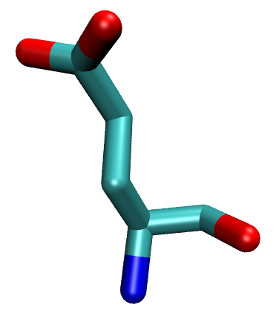
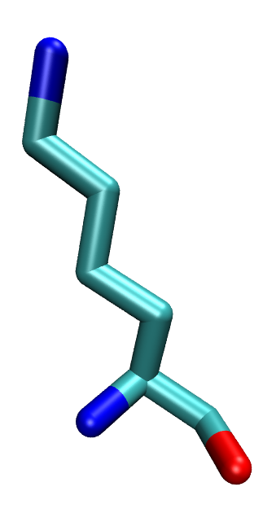
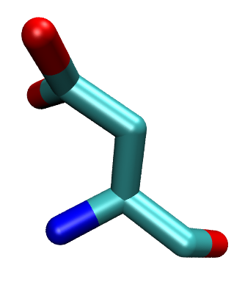
Goal: Validate Computational Electrostatic Techniques Against Experimental Stark Shifts
Rap1a
Glutamic Acid
E30D
Lysine (WT)
G28
Y31
K32
K31E
N54
N29
N27
Aspartic Acid
Glutamic Acid
Ralβ
Ragain, et al., J. Phys. Chem. B 2012
Notes:
As I mentioned before, we are using VSE to look at electrostatic fields at the protein-protein interface. To do so, we have made six different Ral systems, each with a mutation from one interface amino acid to cyanocysteine.
…
Rap K31E (and E30D/K31E) have a Kd of 1.8 and 1.0, respectively
----- Meeting Notes (8/5/15 16:06) -----
"We were interested in for physiological reasons in mutations on 30 and 31..."

Slide 12
Goal: Validate Computational Electrostatic Techniques Against Experimental Stark Shifts
Ragain, et al., J. Phys. Chem. B 2012
Ragain, et al., J. Phys. Chem. B 2012
Notes:
----- Meeting Notes (8/5/15 16:06) -----
ALWAYS TELL US WHAT WE ARE LOOKING AT, don't let the audience get tricked into trying to interpret the bar chart.

Slide 13
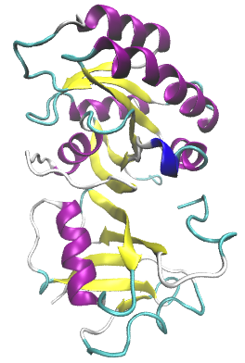
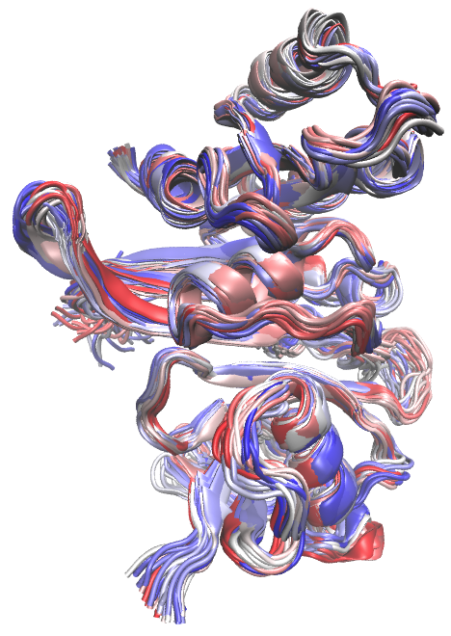
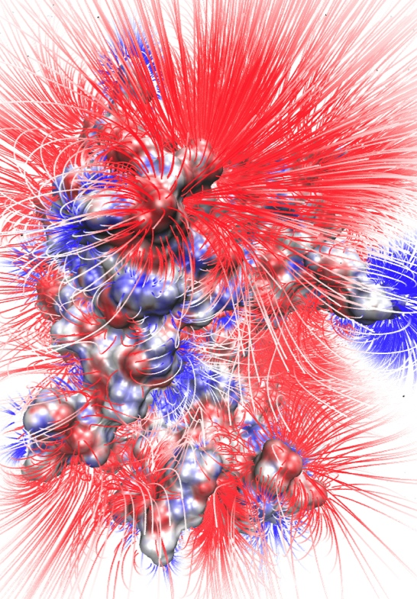
Computational Approach
PDB Structure
MD Ensemble
Electrostatic Field
Electrostatics Model
≤ -1.5
MV/cm⁻¹
T _{initial}
T _{final}
Compare to Experiment
≥ +1.5
MV/cm⁻¹
Assess, Iterate, & Formulate New Hypothesis
Notes:
1. something people can use to predict interesting experiments
2. better molecular understanding and therefore ability to ask interesting physics questions

Slide 14
Computational Approach
PDB Structure
MD Ensemble
Electrostatic Field
Electrostatics Model
≤ -1.5
MV/cm⁻¹
T _{initial}
T _{final}
Compare to Experiment
≥ +1.5
MV/cm⁻¹
Assess, Iterate, & Formulate New Hypothesis
Notes:
1. something people can use to predict interesting experiments
2. better molecular understanding and therefore ability to ask interesting physics questions

Slide 15
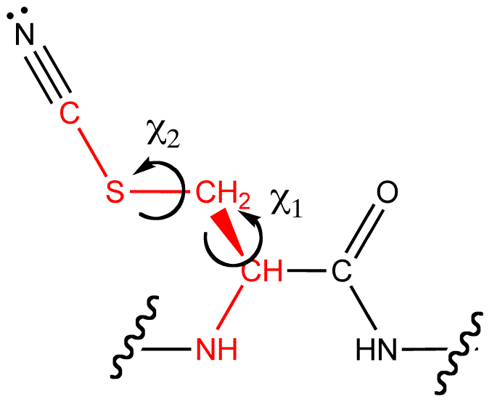
Enhanced Molecular Dynamics: Umbrella Sampling
χ₂ (Degrees)
χ₁ (Degrees)
Notes:
Mention the log scale bar

Slide 16
2D-probability distributions: a test case
High Probability
Low Probability
Notes:
Now one of the first things I wanted to do after deciding to do a 2D sampling strategy was to make sure I knew what to expect from an alkane-like molecule and test the Weighted Histrogram Analysis code my group uses on a 2D system.
To do this I modeled a fictional molecule in which the only contribution to its energy are the chi1 and chi2 dihedral angles, which were each modeled independently using a Ryckaert-Belleman potential function. The main point I wanted to show here is that in 2 dimensions, the probability looks like the product of the 1 dimensional probabilities for an alkane molecule and that, for a perfect test case, I can reproduce the analytic probability distribution.

Slide 17
Simulation Convergence: Tracking The Field
Numeric
RFM
Total Simulation Time (ns)

Slide 18
Simulation Convergence: Tracking The Field
Numeric
RFM
Total Simulation Time (ns)

Slide 19
Outline
Importance of Protein Electrostatics
Vibrational Stark Effect
System: Rap1a Docked to RalGDS
Protein Electrostatic Fields
Poisson Boltzmann vs Reaction Field Method
Select Explicit Water
Electronic Polarizability: AMOEBA
Notes:
Now that we have ensembles of structures, let’s move on to electrostatics calculations

Slide 20
Computational Approach
PDB Structure
MD Ensemble
Electrostatic Field
Electrostatics Model
≤ -1.5
MV/cm⁻¹
T _{initial}
T _{final}
Compare to Experiment
≥ +1.5
MV/cm⁻¹
Assess, Iterate, & Formulate New Hypothesis
Notes:
Let me remind you that we’ve used a refinement approach to how we go about calculating electrostatic fields. This means that we may have started with a single method (PB), but we used the results of that to formulate new hypotheses on the sort of changes that may be required to improve the veracity of these sorts of calculations.

Slide 21
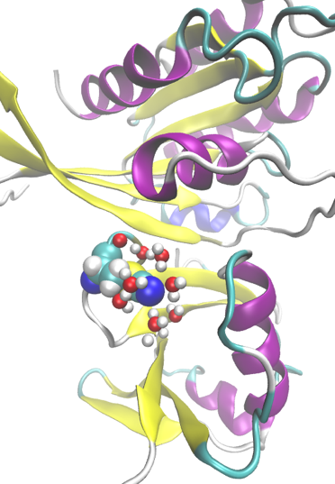
Electrostatics Models
Poisson Boltzmann Implicit Solvent |  | PB w/ Selected Explicit Water
 | Atomic Multipole Optimized Energetics for Biomolecular Applications (AMOEBA)

Slide 22
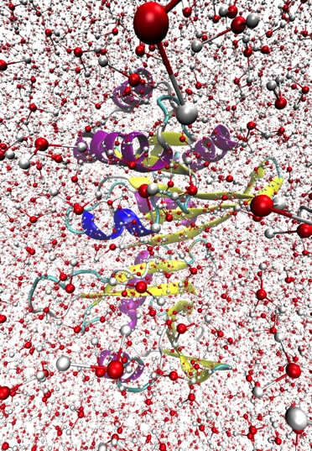
Electrostatics Models
PB Implicit Solvent | PB w/ Selected Explicit Water | Explicit Solvent
AMOEBA | AMOEBA-CP | AMOEBA-CPf
Notes:
----- Meeting Notes (8/3/15 16:39) -----
Waaaaaaaaaay too much detail

Slide 23
Linear Poisson-Boltzmann Equation

Slide 24
Poisson Boltzmann: Reaction Field Method (RFM)
Notes:
We tried using PB straight-out-of-the-box and the results (absolute fields) were poor and inconsistent.
Removing the reference potential from the solvated potential results in only the potential generated by the solvent polarizing about the solute, represented by the rightmost image. The SRF (leftmost image) result being added to the analytical solution to the Coulomb field for all protein atoms in a dielectric ε_{solute}, (middle image), resulting in a total field which uses a numeric solution for the contribution of the implicit solvent and an analytic solution for the contribution of the explicit solute. In this way, numerical errors in the final result are reduced by only solving for part of the system (the solvent) numerically. This also decreases the calculation sensitivity to input parameters such as box size, grid spacing, box location, charge mapping method, etc. Since our initial work, APBS now has the “lrpbe” keyword, which solves for the SRF directly without requiring a reference calculation.
APBS has a keyword that solves the PBE (using finite difference) in this manner (lrpbe)
----- Meeting Notes (8/5/15 16:06) -----
Add PB equation after "Poisson Boltzmann: "

Slide 25
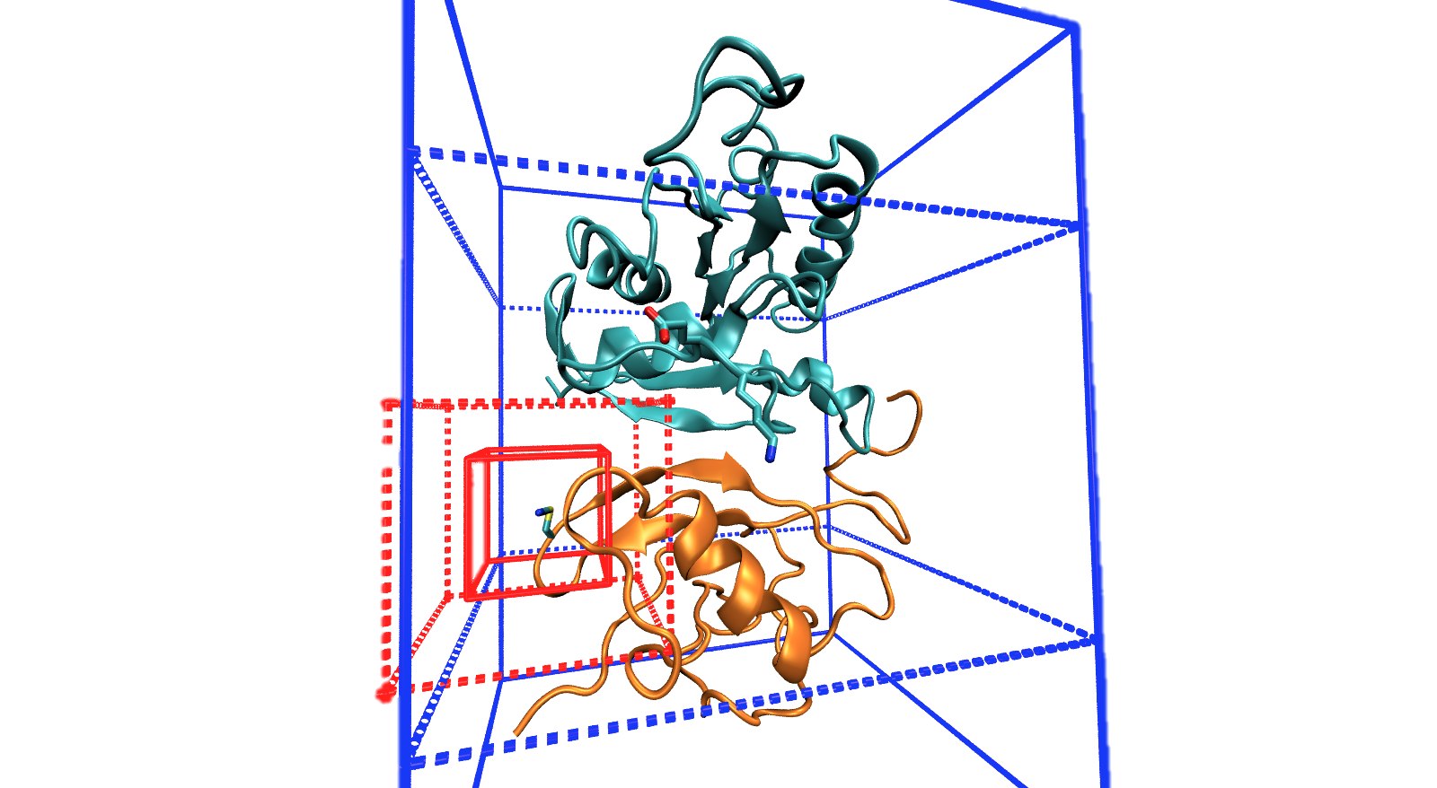
PB Grid Location
Original box
New box
Notes:
Finally, I’m also working on a set a even coarser grid-spacings in which the second stage boxes encompass approximately half and approximately all of the protein each. The idea here is to determine whether the box size or the grid spacing is more important. I do not yet have any examined data for this strategy.
Because APBS is very highly tunable, one of the challenges is determining which parameters are most important and whether or not it’s physically reasonable. Right now, focusing on the box positions, I’m trying to come up with a consistent metric for determining how to decide the location, size, and grid spacing that is the most useful combination of accurate and quick.

Slide 26
PB Grid Location: 60 Å, 0.25 Å Between Grid Points
Numeric Field
RFM Field
Calculated Field
(k_{b}T/eÅ)
Experimental Absorption Energy (cm⁻¹)
Calculated Change
in Field (k_{b}T/eÅ)
Experimental Change in Absorption Energy (cm⁻¹)

Slide 27
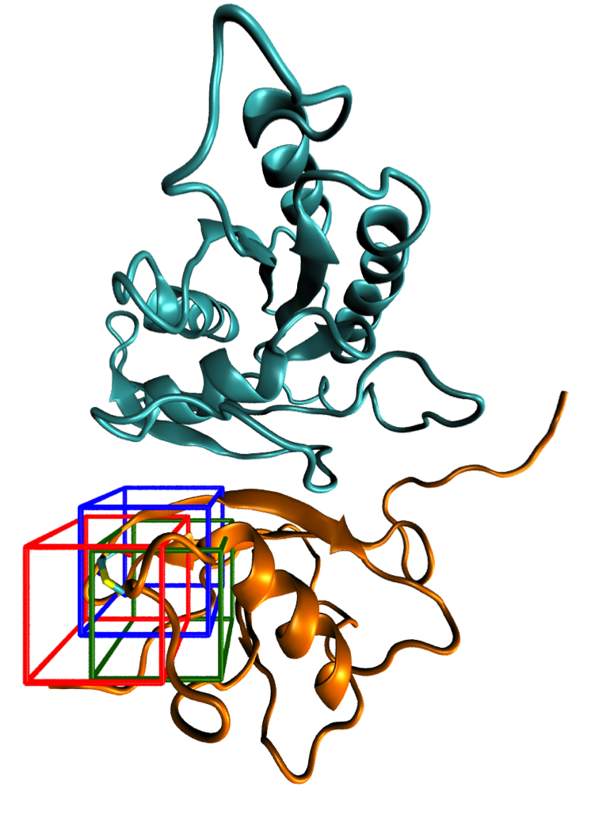
PB Grid Location: Small Boxes
Red: Center of nitrile Cδ
Green: Shifted towards Ralβ center of mass
Blue: Shifted towards system center of mass

Slide 28
PB Grid Location: 19 Å, 0.099 Å Between Grid Points
Numeric Field
RFM Field
Red: Center of nitrile Cδ
Green: Shifted towards Ralβ center of mass
Blue: Shifted towards system center of mass
Calculated Field
(k_{b}T/eÅ)
Experimental Absorption Energy (cm⁻¹)
Calculated Change
in Field (k_{b}T/eÅ)
Experimental Change in Absorption Energy (cm⁻¹)
Notes:
Large box numeric weakly sensitive to grid location.
Large box RFM has higher correlation, shows sensitivity to box.
Correlations increased in numeric difference but not RFM difference

Slide 29
PB Grid Location: 10 Å, 0.052 Å Between Grid Points
Numeric Field
RFM Field
Red: Center of nitrile Cδ
Green: Shifted towards Ralβ center of mass
Blue: Shifted towards system center of mass
Calculated Field
(k_{b}T/eÅ)
Experimental Absorption Energy (cm⁻¹)
Calculated Change
in Field (k_{b}T/eÅ)
Experimental Change in Absorption Energy (cm⁻¹)
Notes:
Small box numeric VERY sensitive to box location
Small box RFM much less sensitive
Correlations increased in numeric difference but not RFM difference

Slide 30
Conclusions
Center the grid on the region of interest; do not try to optimize the grid location. Instead opt for the highest feasible grid point density.
Use the numeric solution to the PB equation when trying to evaluate the difference in fields.
Use the RFM when the actual field values are important.

Slide 31
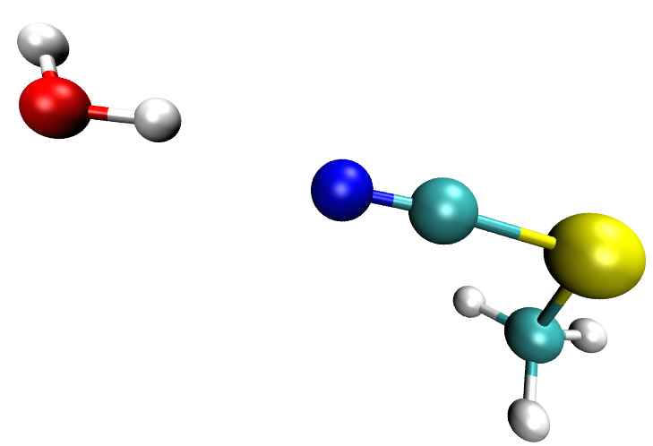
PB: Including Selected TIP3P Water Molecules: 5 Å Water Sphere, Nearest, Hydrogen-Bonding
r_{NH} ≤ 2.25 Å
NHO ≥ 138˚
Le Questel, et al., J. Phys. Org. Chem. 2000
Schiffer, et al., J. Am. Chem. Soc. 2013
Notes:
Trying to be very generous with hydrogen bonding criteria

Slide 32
PB Including Selected TIP3P Water Molecules: 5 Å Water Sphere
Numeric Field
RFM Field
Implicit Solvent
5 Å Water Sphere
Calculated Field
(k_{b}T/eÅ)
Experimental Absorption Energy (cm⁻¹)
Calculated Change
in Field (k_{b}T/eÅ)
Experimental Change in Absorption Energy (cm⁻¹)
Notes:
Sphere does not help either calculation methods
Correlations increased in numeric difference but not RFM difference
If a water was within 5 Å of the nitrile, it remained within 5 Å for an average of 20±4.2 frames

Slide 33
RalGDS Monomer: The only example of the 5 Å Water Sphere Improving Correlation
Numeric Field
RFM Field
Calculated Field
(k_{b}T/eÅ)
Experimental Absorption Energy (cm⁻¹)

Slide 34
PB Including Selected TIP3P Water Molecules: Hydrogen-Bonding Water
Numeric Field
RFM Field
Implicit Solvent
Hydrogen-Bonding Water
Calculated Field
(k_{b}T/eÅ)
Experimental Absorption Energy (cm⁻¹)
Only 9.92% of frames had a nitrile-water hydrogen bond
Calculated Change
in Field (k_{b}T/eÅ)
Experimental Change in Absorption Energy (cm⁻¹)
Notes:
H-bonding also does not help
Correlations increased in numeric difference but not RFM difference
9.92% of frames had a nitrile-water hydrogen bond

Slide 35
PB Including Selected TIP3P Water Molecules: Nearest Water Molecule
Numeric Field
RFM Field
Implicit Solvent
Nearest Water
Calculated Field
(k_{b}T/eÅ)
Experimental Absorption Energy (cm⁻¹)
Calculated Change
in Field (k_{b}T/eÅ)
Experimental Change in Absorption Energy (cm⁻¹)
Notes:
Nearest water does not help
Correlations increased in numeric difference but not RFM difference

Slide 36
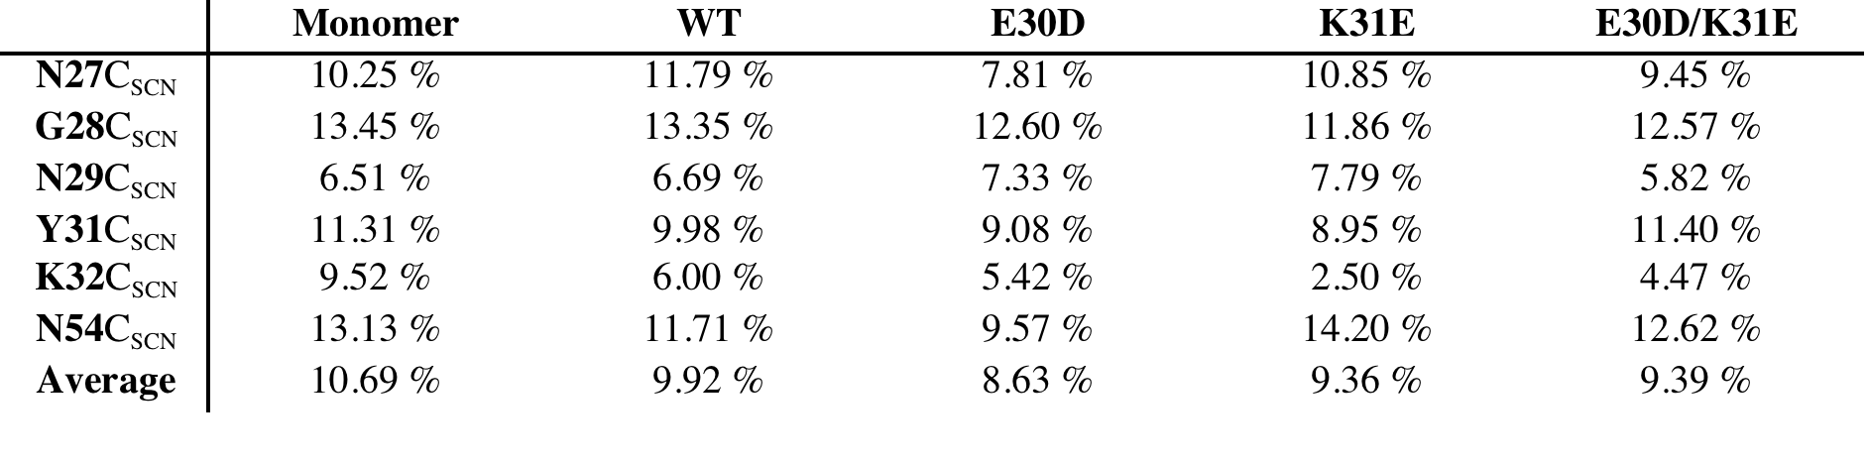
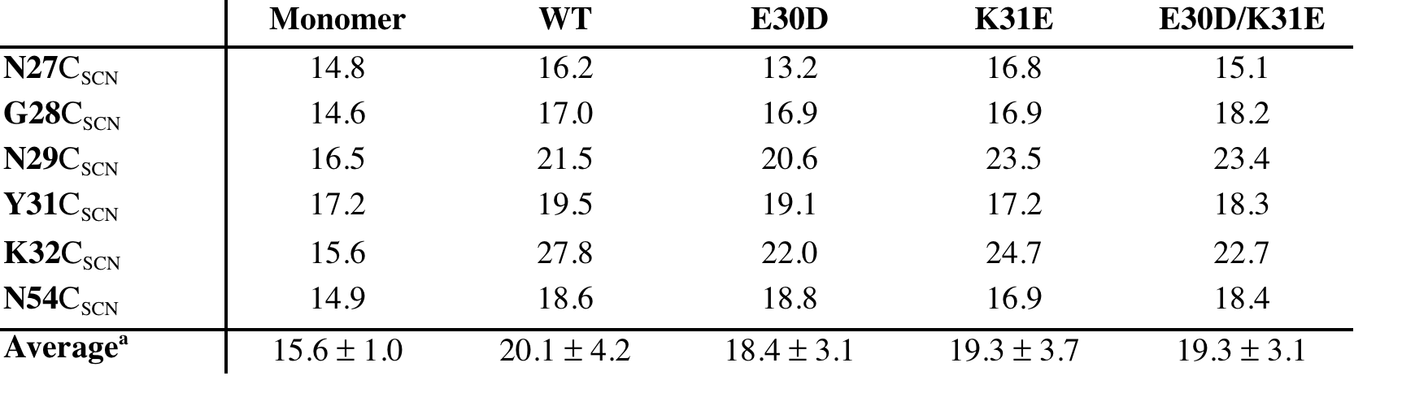
PB: Including Selected TIP3P Water Molecules
Percentage of Frames with a Nitrile-Water Hydrogen Bond
Average Number of Frames Water Remained within 5 Å of Nitrile

Slide 37
Conclusion
Generally, do not include an explicit water sphere for a PB calculation. Although it can be beneficial, it must be justified after-the-fact and is subject to the quality of the water sampling.
In a system with little hydrogen-bonding to water, do not include those water molecules. Further study is required for generalizations about a system with more-significant hydrogen bonding.
Do not include the nearest water molecule.

Slide 38
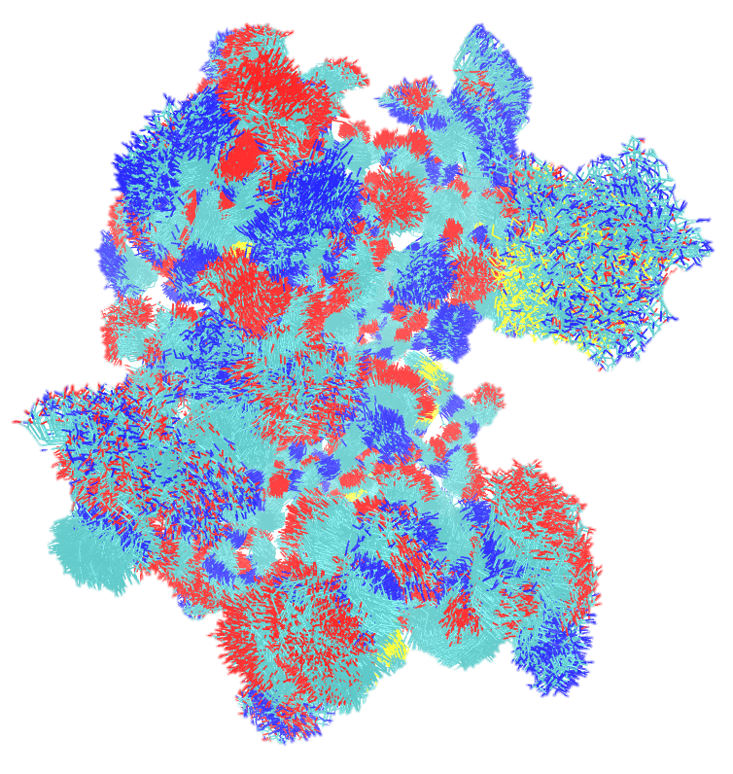

Explicitly Modeling Electronic Polarizability: AMOEBA

Slide 39
AMOEBA Fields From Amber03 Structural Ensembles Are Less Correlated to Experiment than PB Fields
Notes:
For systems where dynamics were generated in a point charge force field (Amber03), fields calculated via the polarizable AMOEBA force field are generally worse than those calculated using PB with point charges

Slide 40
Conclusion
When calculating fields using the AMOEBA force field, dynamics should also be performed using AMOEBA. It is likely that the ensembles are not transferable; Amber03 includes orientational polarization (via MD), while AMOEBA incorporates both orientational (via MD) as well as electronic polarization; low energy orientations likely differ.

Slide 41
Conclusions: Electrostatics Models
Poisson Boltzmann Implicit Solvent |  | PB w/ Selected Explicit Water
 | Atomic Multipole Optimized Energetics for Biomolecular Applications (AMOEBA)
Center the grid on the region of interest and use the highest grid point density feasible
Use the numeric solutions to the PB equation for comparing differences in fields and the RFM for comparing actual field values
Do not explicitly include a solvent sphere or nearest water.
When hydrogen-bonding is rare, do not include hydrogen bonding water molecules.
Ensembles are not transferable
Sampling using the force field defining the electrostatic model

Slide 42
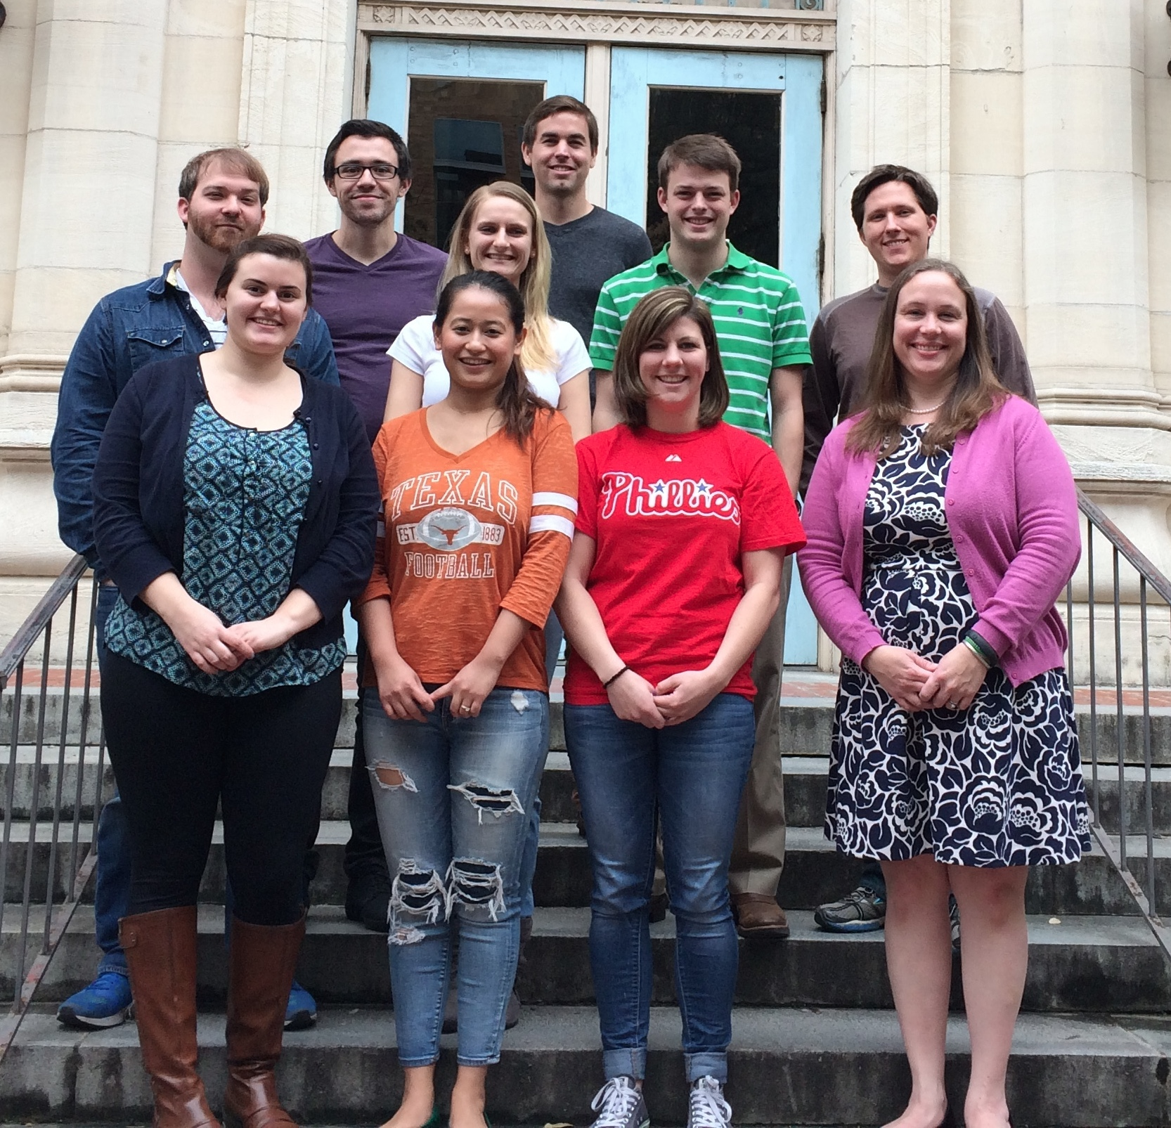
Acknowledgements
Advisor
Lauren J. Webb, Ph.D.
Graduate Students
Cari Anderson
Jason Dugger
Whitney Fies
Jeremy First
Seth Norman
Elisa Novelli
Rebika Shrestha
Josh Slocum
Previous Graduate Students and Post Docs
Daniel Ensign, Ph.D.
Christina Ragain, Ph.D.
Amy Stafford
David Walker, Ph.D.
Undergraduates
Kelsey Eklund
Santiago Sanchez
Funding
Burroughs Welcome Fund
The Welch Foundation
The University of Texas at Austin
Collaborators
Pengyu Ren, Ph.D. (BME)
Michael Schnieders, Ph.D. (Iowa)
Facilities
TI3D
TACC

Slide 43
Enhanced Molecular Dynamics: Umbrella Sampling

Slide 44
Enhanced Molecular Dynamics: Umbrella Sampling

Slide 45
Enhanced Molecular Dynamics: Umbrella Sampling

Slide 46
The Case for Electronic Polarizability: AMOEBA
Notes:
----- Meeting Notes (8/3/15 16:18) -----
backup

Slide 47
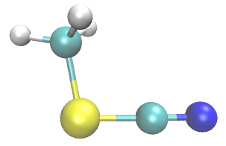
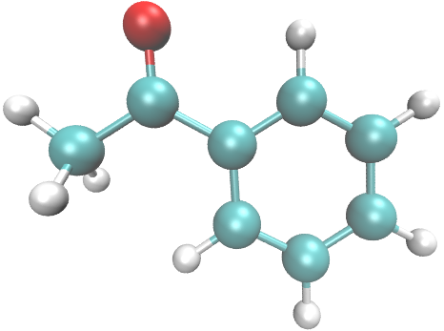
The Case for Electronic Polarizability: AMOEBA
Ragain, Slocum, Eklund
Fried, S. D., et al. J Am Chem Soc 2013.
Notes:
----- Meeting Notes (8/3/15 16:18) -----
Backup

Slide 48
Calculating Fields in AMOEBA

Slide 49
Potential, Field, and Induced Dipole Expressions

Slide 50
Electrostatic Frame Clustering: Taking advantage of a weighted average

Slide 51
Electrostatic Frame Clustering: Taking advantage of a weighted average

Slide 52
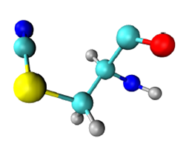
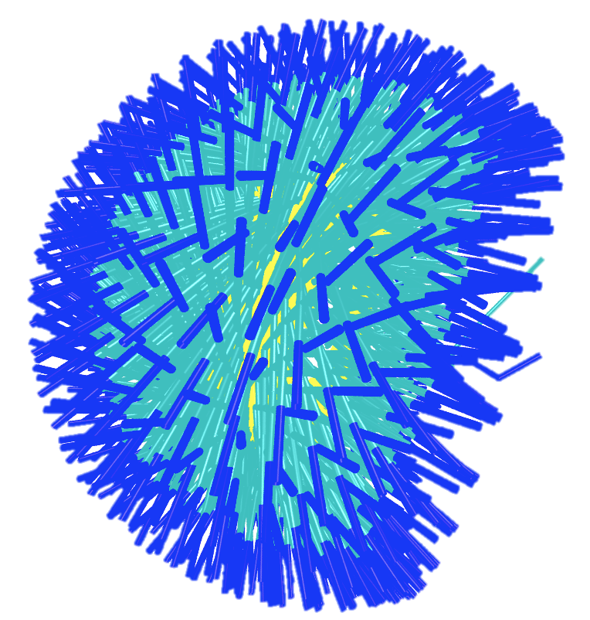
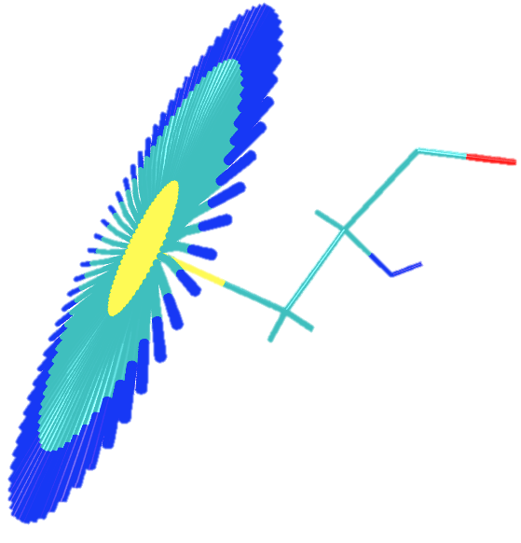
MD: sampling methods
Old (1D)
χ₁
18 ns
New (2D)
χ₁ + χ₂
57.6 ns
Cδ
Cα
Sγ
N
Cβ
χ₁
χ₂
Notes:
The most impactful difference between sampling two degrees of freedom rather than one are the dipole moment vectors of the nitrile probe. The reason for using umbrella sampling is because there are potential energy barriers that are not likely to be surpassed over a reasonable simulation time at biologically relevant temperatures. The nitrile probe used has two relevant torsional degrees of freedom beyond the backbone. By just biasing a single degree of freedom, chi 2, an ensemble of structures are generated which nearly all have the same chi 1 dihedral and incompletely samples the 3 dimensional dipole vector space.
Using 2D umbrella sampling, however, creates a more-complete picture of probe dipole vectors, which is relevant for the magnitude of the VSE.

Slide 53
2D-WHAM
Convert 2D-problem to 1D-problem
Bin(0,0)=0, Bin(0,1)=1, …
For 72x72 5º bins, 5184 total bins
Convert 1D python script to C++
Bug found! Fix and test against known potential
Ryckaert-Bell alkane potential:
C_{n}={9.28, 12.16, -13.12, -3.06, 26.24, -31.5}

Slide 54
Stark turning rate and dielectric constant
Stark effect
Linear PBE

